Slide 1
Benazir Second regime
1993 to 1996

Slide 2
presenters
Ahmed Faraz
Moizuddin
Talha Islam

Slide 3

introduction
after the resignation of both President Ghulam Ishaq Khan and Prime Minister Nawaz Sharif on July 18, 1993.
The resignation led to the announcement of fresh elections for the National and Provincial Assemblies.
The elections were held on October 6 and 9, 1993
Pakistan People’s Party (p.p.p) won with majority of seats and formed the new government.

Slide 4
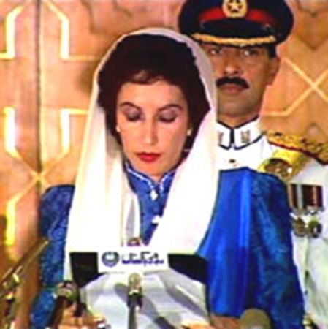
INTRODUction
Benazir Bhutto took oath as Prime Minister on October 19, 1993
After the formation of government presidential elections took place
Farooq ahmed leghari from (p.p.p) elected as 8th president on 14 november 1993
He won by 274 votes against 168 votes
During her second term she appointed both her husband and mother to her cabinet

Slide 5

Problems faced
The racial violence in Karachi was reached at peak and became a biggest problem for Benazir Bhutto
The MQM attempted to make an alliance with Benazir Bhutto under their own conditions, but Benazir Bhutto refused
Operation Blue Fox was launched to politically vanishe the MQM from country’s political spectrum
resulted in thousands killed or gone missing, with majority contains Urdu-speaking.

Slide 6
Policy on taliban
Pakistan-backed extremely religious group, the Taliban, took power in Kabul in September 1996.
Taliban gained prominence in Afghanistan and many of her government had backed the Taliban for gaining the control of Afghanistan.
She continued her father’s policy on Afghanistan taking measures to curb down the anti-pakistan sentiments in Afghanistan.
Under her government, Pakistan had recognized the Taliban regime as legitimate government in Afghanistan, allowing the Taliban to open an embassy in Islamabad.

Slide 7

Corruption
The corruption grew during her government, and her government became increasingly unpopular and corruption scandals became public.
One of the biggest scandal was Agosta Submarine scandal.
It was on mansurul haq which was four star rank admiral of Pakistan navy in the process of technology transfer of submarines from France.
In Switzerland, the Swiss Government handed over documents to the government of Pakistan which relate to corruption allegations against Benazir Bhutto and her husband.

Slide 8
Decline of government
Her younger brother also effect her government. Murtaza bhutto was notably gunned down in a police encounter with sindh police. her younger brother’s death had devastating on party and policies.
Qazi hussian ahmed of jamaat-e-islami announced to start protest against benazir government alleging corruption.
Criticism against benazir came from powerful political spectrum of punjab and Kashmir province, who opposed benazir bhutto.
On 05 November 1996, President farooq leghari dismissed Benazir bhutto’s government on charges of corruption and mismanagement, under the article of 58(2)b of eight amendment.

Slide 9

Question & answer

